Slide 1
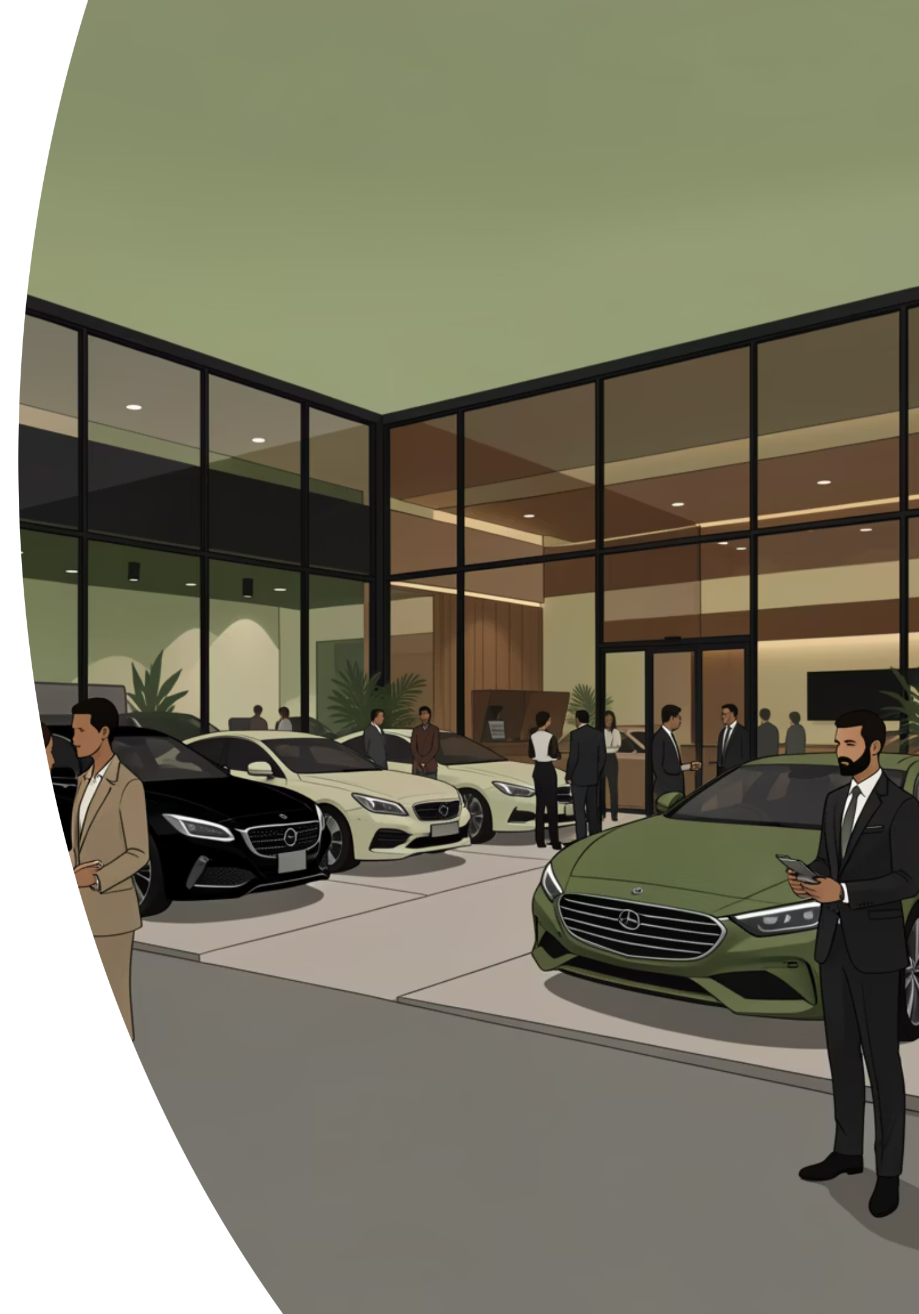
Nguvu Automotive: Accelerating into Nairobi
A strategic business case for expanding our premium automotive dealership in Kenya's vibrant capital.

Slide 2

Executive Summary: Why Nairobi is Our Next Destination
Based on a comprehensive analysis of economic strength, customer base, competitive landscape, and infrastructure, Nairobi stands out as the optimal location for Nguvu Automotive's new premium dealership branch.
Economic Capacity
Affluent Population
Developed Ecosystem
Stronger economic output and purchasing power drive market growth.
High concentration of high-net-worth individuals ensures a robust customer base.
Advanced finance, services, and dealership infrastructure support premium sales.
Nairobi's dynamic market offers unparalleled potential for growth and brand positioning.

Slide 3
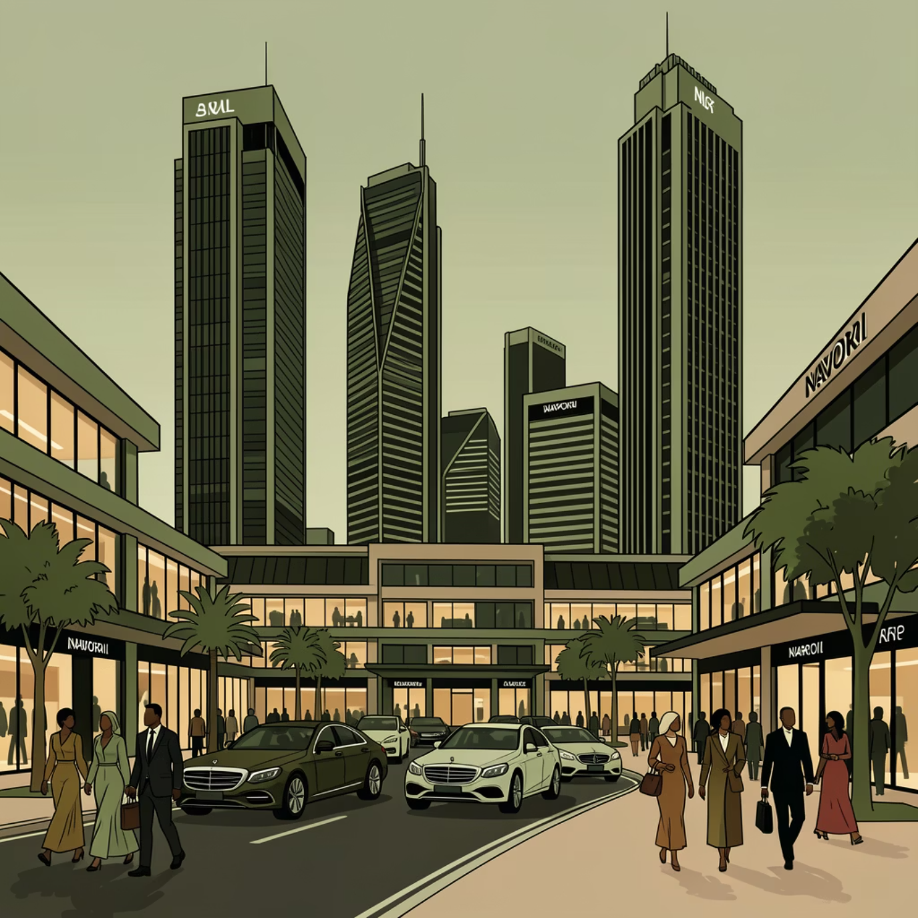
CHAPTER 1
Market Demand & Customer Base: A Deep Dive
Nairobi significantly outpaces Mombasa in both economic output and wealth, directly impacting the demand for premium automobiles.
Population & Affluence
Nairobi's GCP per capita: KSh 802,344 vs. Mombasa's KSh 507,337, indicating higher average purchasing power.
Wealth Concentration: Nairobi houses 70% of households in the highest national wealth quintile.
High-Net-Worth Individuals (HNWIs): Approximately 4,700 HNWIs in Nairobi, compared to ~700 in Mombasa.
This strong concentration of wealth in Nairobi translates to a robust demand for luxury vehicles, driven by status and aspirational purchases.

Slide 4

CHAPTER 2
Economic & Business Environment: Nairobi's Advantage
Nairobi's diversified and robust economy provides a stable foundation for sustained premium product consumption, unlike Mombasa's more specialized economic drivers.
Nairobi: Kenya's Economic Powerhouse
Mombasa: Trade-Centric Economy
27.5% of Kenya's total economic value, driven by:
Contributes 4.8–5% of Kenya's economic value, primarily from:
Finance and corporate headquarters
International organizations and multinationals
Port trade and logistics
High technology and professional services
Tourism and hospitality
Regional trade hub

Slide 5
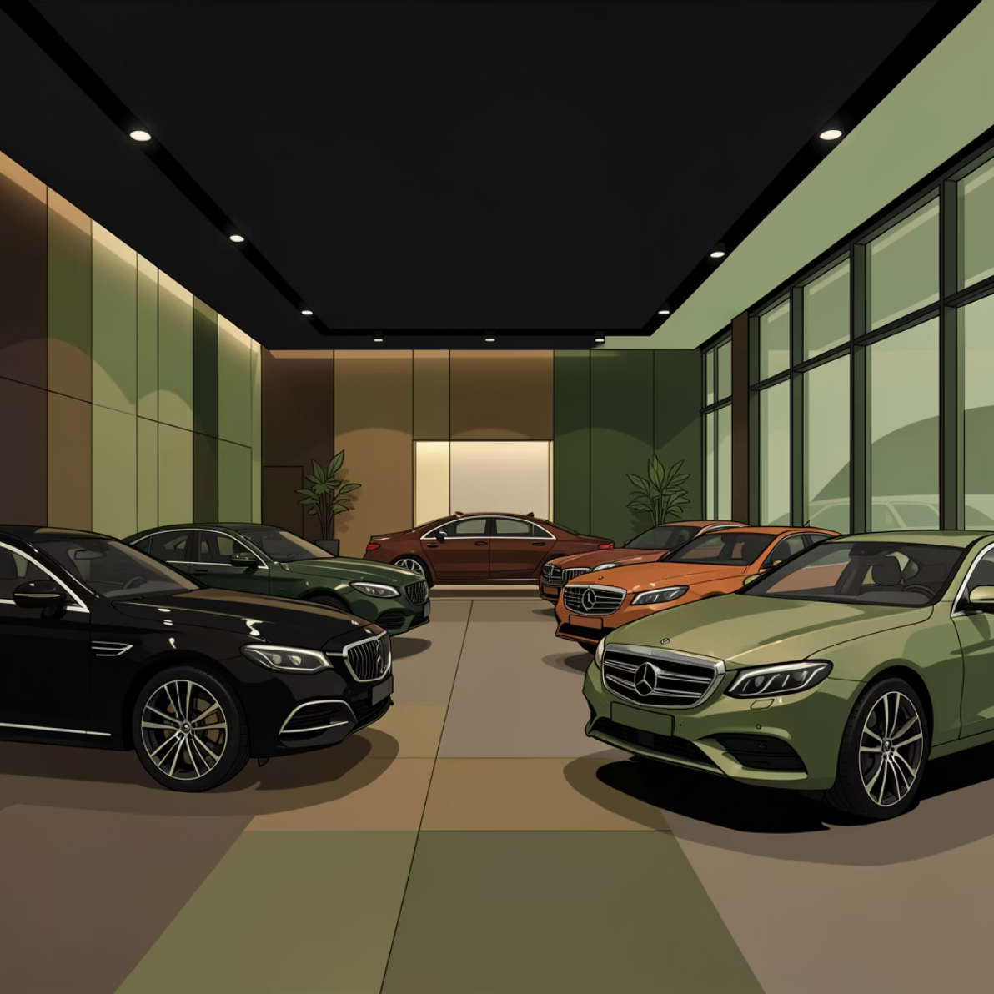
CHAPTER 3
Automotive Market & Competitive Landscape
Nairobi is the established hub for premium automotive dealerships, indicating a proven market and competitive viability for Nguvu Automotive.
Dealership Presence in Nairobi
Mascardi: Houses BMW, Mercedes-Benz, Porsche.
Al Siddique Motors: Offers a range of premium and luxury vehicles.
Market Concentration
Nairobi dominates automotive finance and dealership networks, leading in new and used car transactions.
Competitive Insight: Our world-class customer experience and brand differentiation will enable us to thrive within this established market.

Slide 6
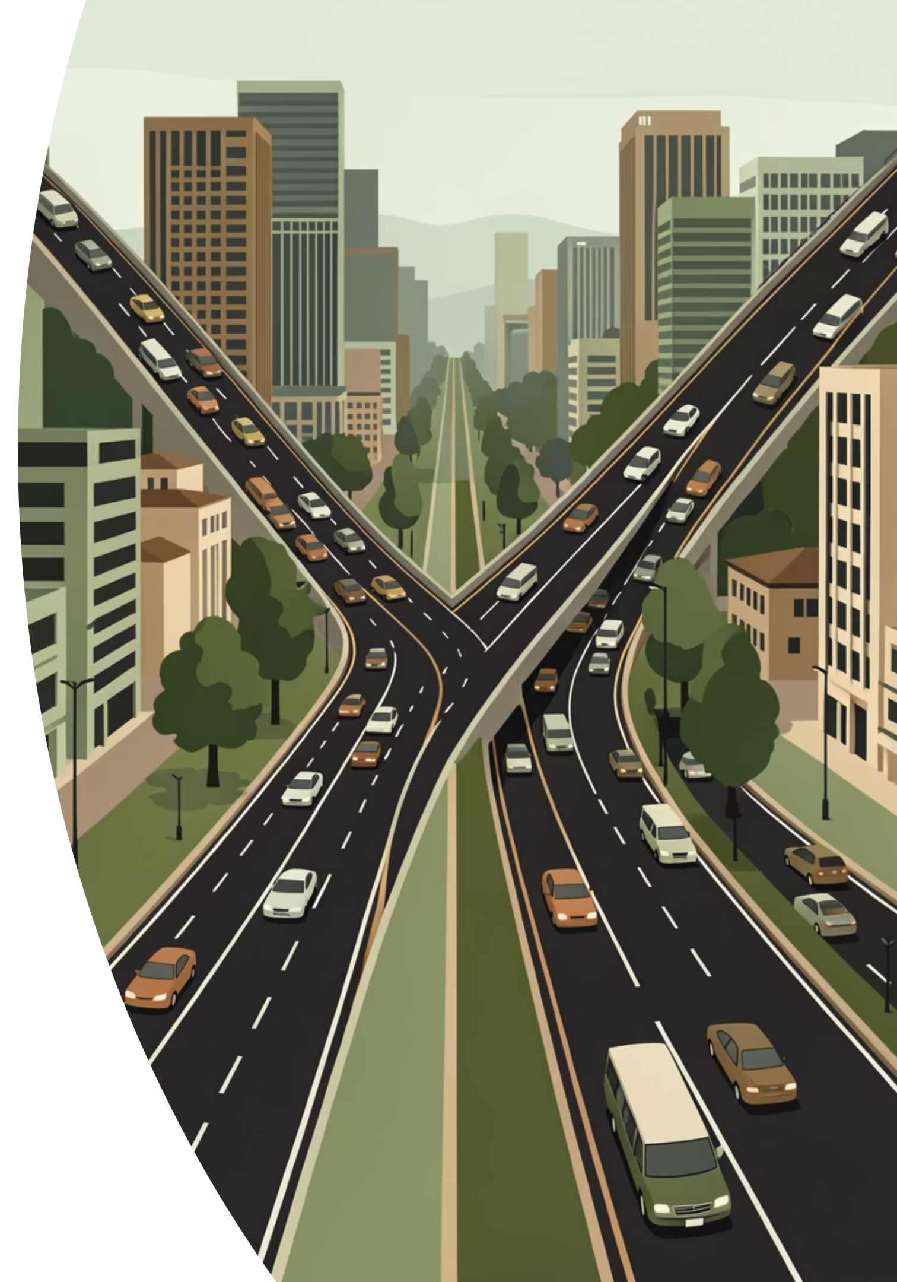
CHAPTER 4
Infrastructure & Accessibility: Supporting Premium Sales
Nairobi's well-developed infrastructure directly supports the high-volume, high-value transactions characteristic of the premium automotive market.
Automotive Ecosystem
1
Dense network of service centers, specialized finance, and robust supply chains.
Road Connectivity
2
Extensive road networks facilitate showroom traffic and wider market reach.
Mombasa's Port
3
Strategic for imports but less relevant for direct retail demand of new premium cars.

Slide 7

CHAPTER 5
Operating Costs & Business Environment
While Nairobi presents higher operating costs, the potential for greater sales volumes and stronger brand positioning offers a significantly higher return on investment.
Location Costs vs. Payback Potential
Business Facilitation
Nairobi's commercial real estate and operational expenses are higher, reflecting its premium market status. However, the anticipated sales volume and enhanced brand visibility promise a greater payback.
Nairobi boasts a more robust ecosystem for financial services, credit markets, insurance, and after-sales support, crucial for premium sales growth.
Strong financial services
Developed credit markets
Comprehensive dealership support systems

Slide 8

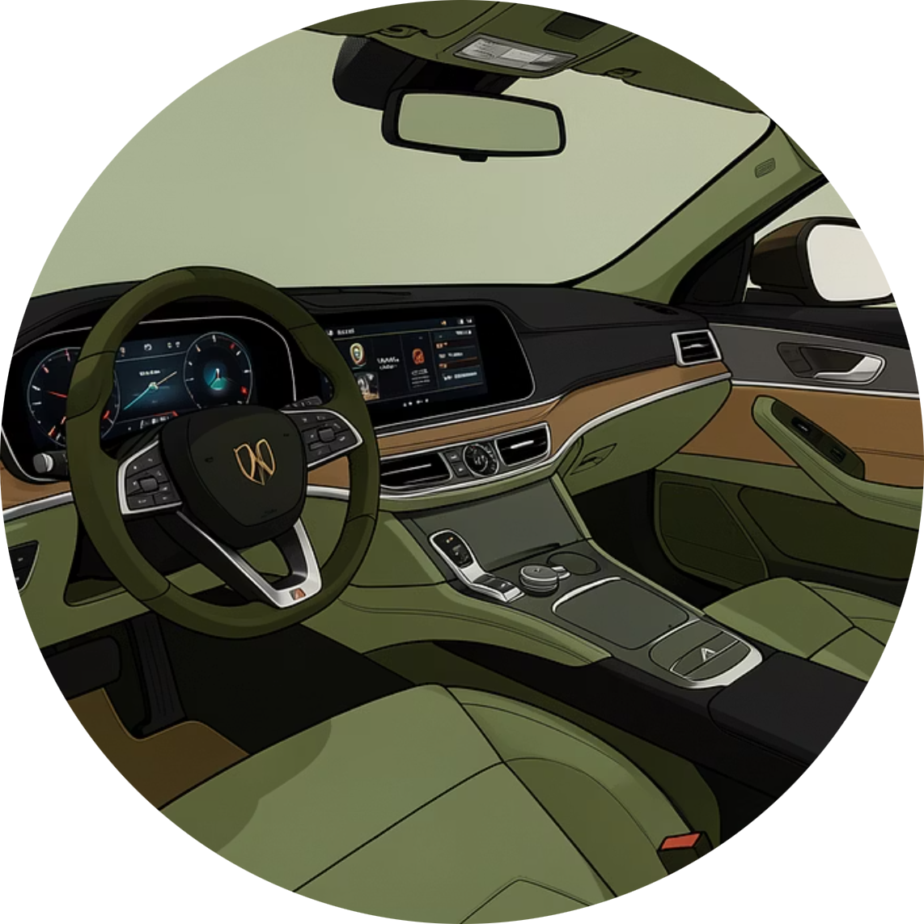
CHAPTER 6
Lifestyle & Brand Fit: Resonating with Nairobi's Elite
Nairobi's affluent demographic exhibits a distinct demand for premium automobiles, driven by corporate culture, expatriate lifestyles, and status signaling.
Consumer Sentiment
Brand Experience
High demand for premium vehicles as symbols of success and status.
Expectations for superior after-sales service, customization, and financing options are met by Nairobi's market infrastructure.
Targeting upscale neighborhoods like Muthaiga, Kyuna, and Kilimani will ensure direct access to our core customer base.

Slide 9
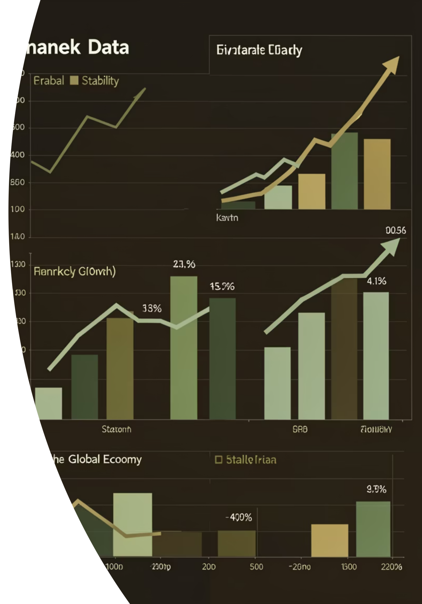
CHAPTER 7
Risk Assessment: Mitigating Challenges
While Kenya's broader automotive market faces sensitivities, Nairobi's diverse economy offers a more resilient customer base and reduced market risk compared to Mombasa.
1
Economic Variability
Exposure to exchange rate fluctuations and import duties. Nairobi's diversified economy provides a buffer against these impacts.
2
Market Risk
Mombasa is sensitive to seasonal tourism. Nairobi's diverse economic drivers ensure steadier demand for premium vehicles.

Slide 10





Final Recommendation: Invest in Nairobi
Nguvu Automotive is uniquely positioned for success by launching its new premium dealership in Nairobi.
Financial Ecosystem
Access to a developed financial ecosystem and wealthy buyers.
Strong Demand
Existing robust demand for premium and luxury vehicles.
Strategic Positioning
Opportunity for strategic brand placement within a competitive landscape.
Growth Potential
Long-term growth and risk diversification in a resilient market.
By establishing our presence in upscale districts and leveraging strategic partnerships for financing and after-sales, Nguvu Automotive will unlock significant growth.

